Slide 1
PROJECT PRESENTATION ON Gujarat RTO

Slide 2
GUJARAT RTO
Submitted By :-
Tada Viral
Submitted To :-
Government Polytechnic Gandhinagar
Internal Guide :-
Bhavin Madhani
External Guide :-

Slide 3
GUJARAT RTO
Project Title :- GUJARAT RTO
Platform :- Microsoft Windows 10
Front End :- HTML & Bootstrap
Back End :- PHP Core
Development Tools :- PHP Core
MYSQL
Web Server :- Apache server
Submitted To :- Gujarat Technological University.

Slide 4
GUJARAT RTO
Hardware Requirement :-
Processor :- Intel core i7
RAM :- 4 GB
Hard disk :- 500 GB
Software Requirement :-
Operating System :-Windows- 8,Windos-10
Front end tool :- PHP, Codeigniter
Back end tool :- MySql
Browser :- Google Chrome , Mozilla Firefox

Slide 5
GUJARAT RTO
Objectives :-
The main objective of the project RTO, user is to book Online Exams Date, Vehicle Registration number, license, RC Book.
The Administrator is providing for authentication purpose as well as it handles all the database of RTO and manages all the process
It help to reduce the RTO work manually and it helps to save the time of the user
This process intends to help the customer in saving their time
It also helps RTO officials to maintain records systematically and reduce a lot of paper work

Slide 6
GUJARAT RTO
Admin Section :-
Maintain the administrator username and password.
Queries or comments are posted by user.
Reply queries or comments to the user.
Admin can edit this information and in user view these.
These updates are viewed in the payment package details in user view section.
Maintains the Job name, days allowed, number jobs. The admin update and delete and
add these details.
Send the news letter about the jobs site to the job seekers.
Send the news letter about the jobs site to the recruiters.
Maintain active and inactive job.

Slide 7
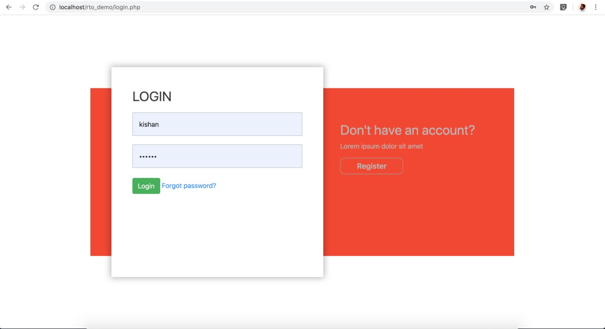
User Side:

Slide 8
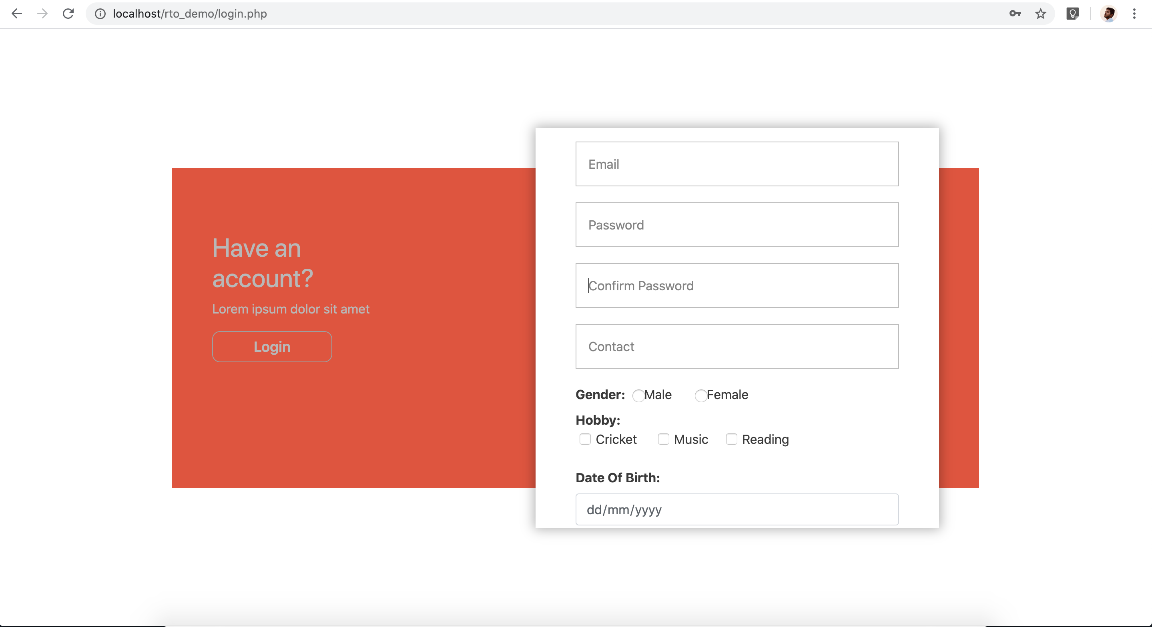

Slide 9
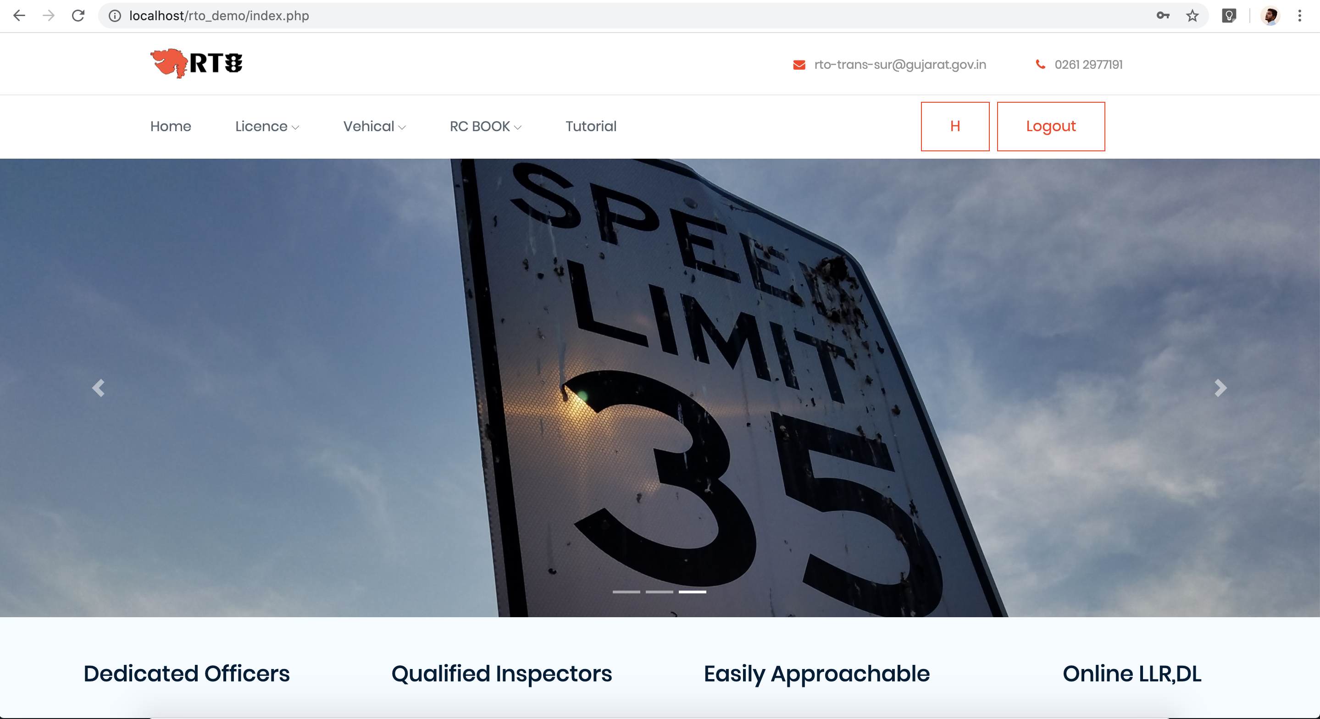

Slide 10
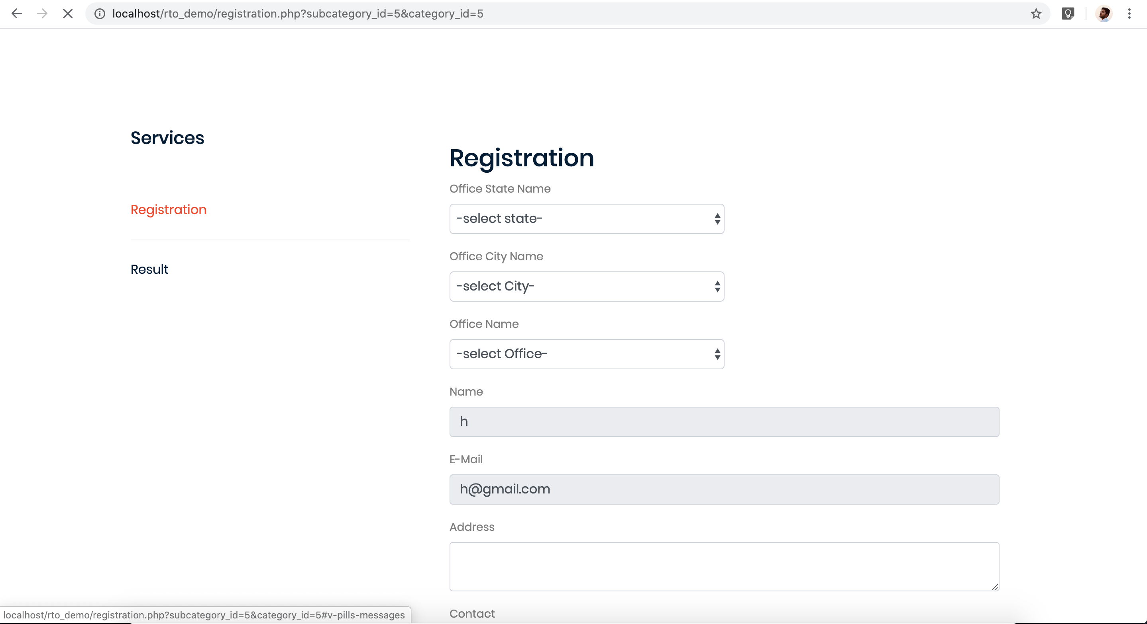

Slide 11
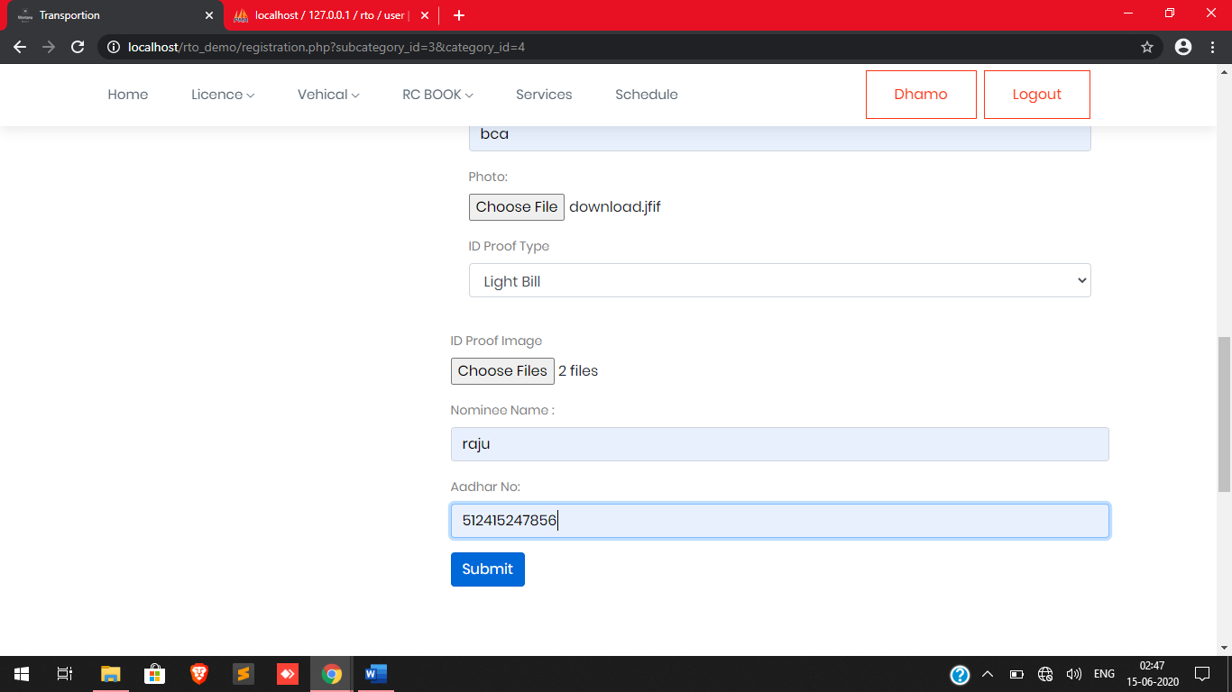

Slide 12
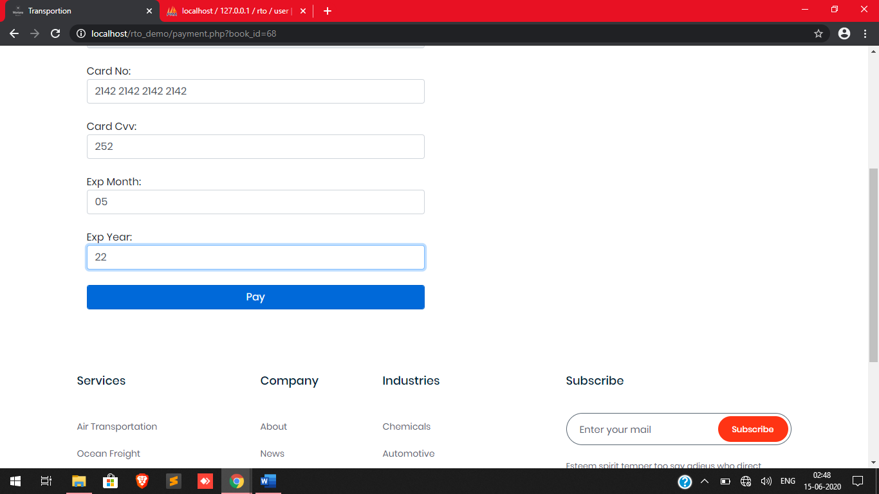

Slide 13
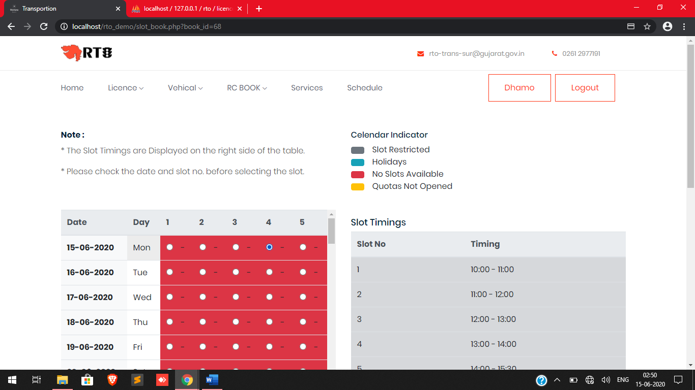

Slide 14
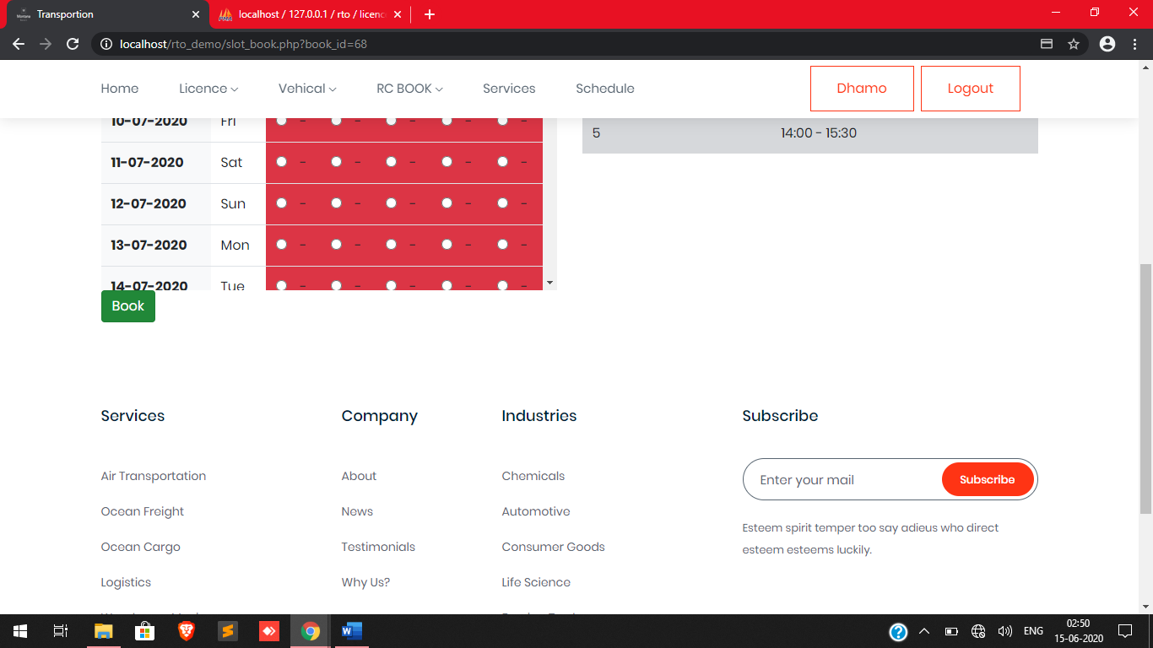

Slide 15
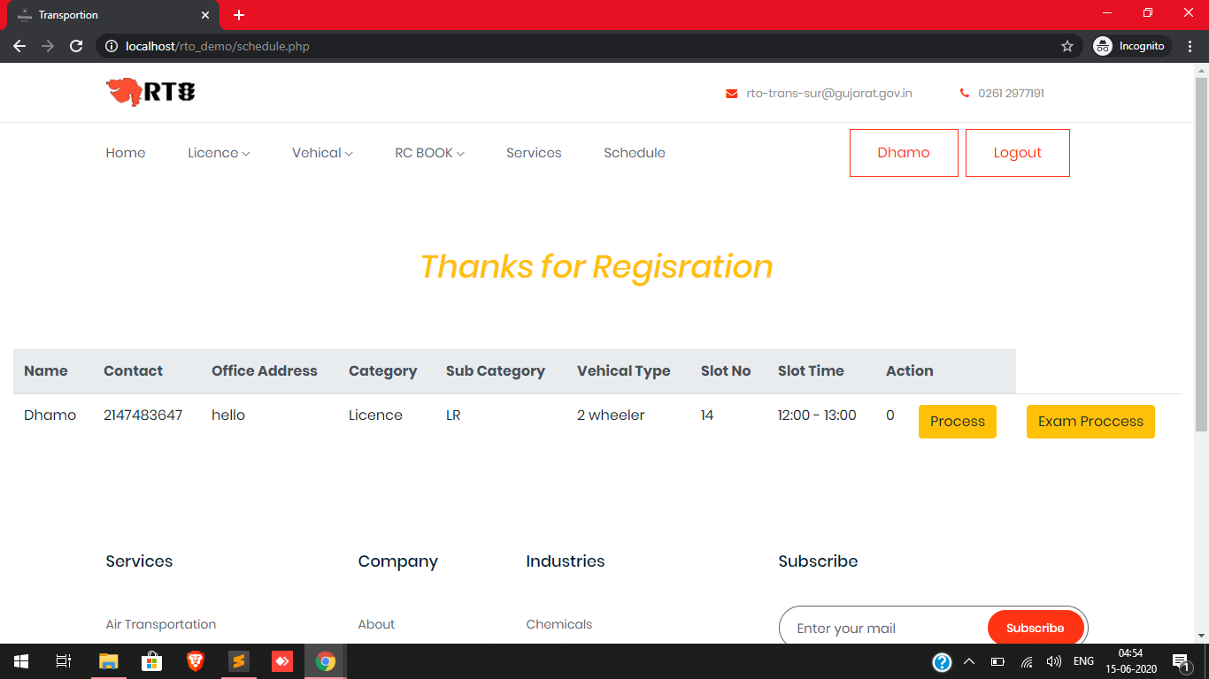

Slide 16
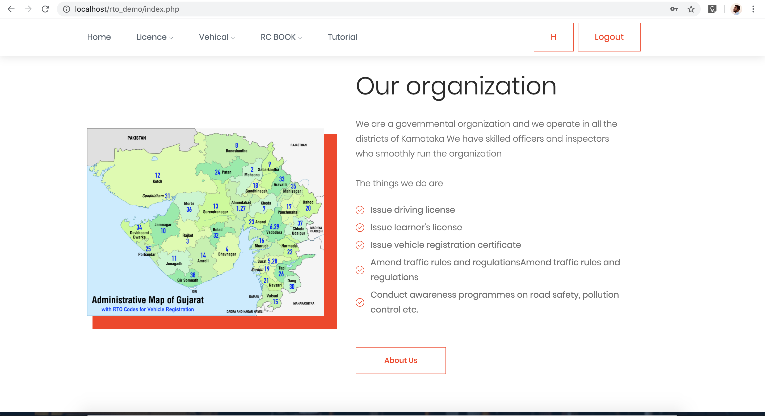

Slide 17
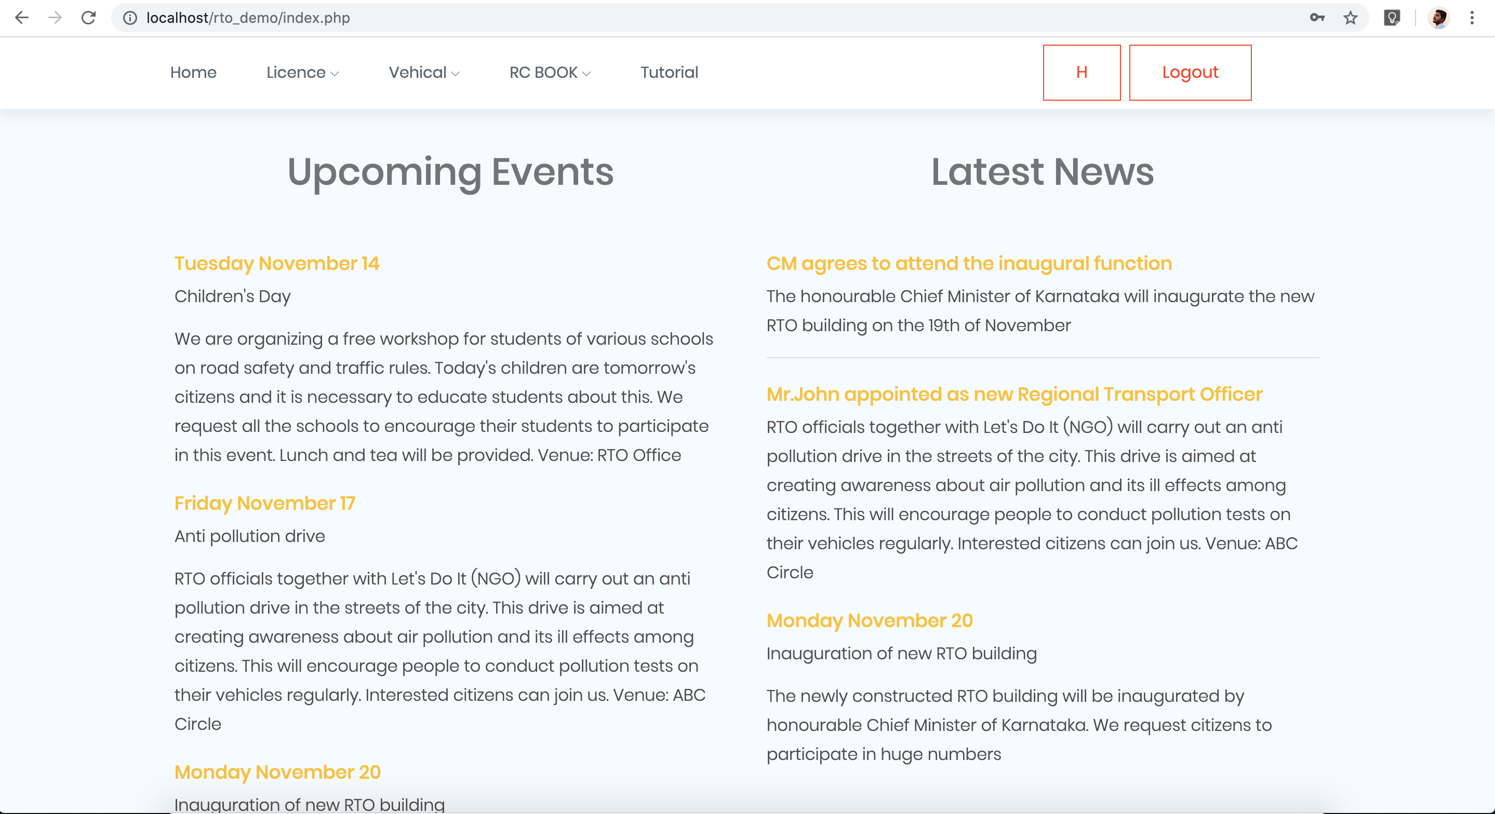

Slide 18
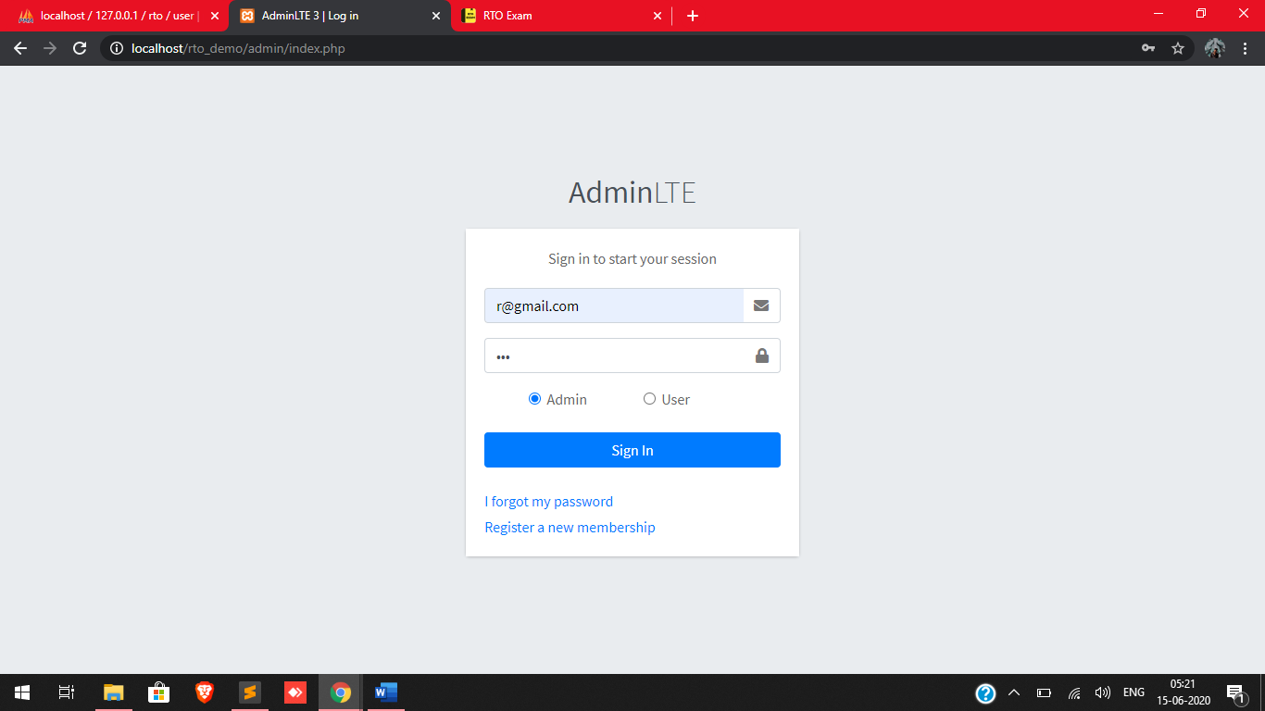
Admin Side:

Slide 19
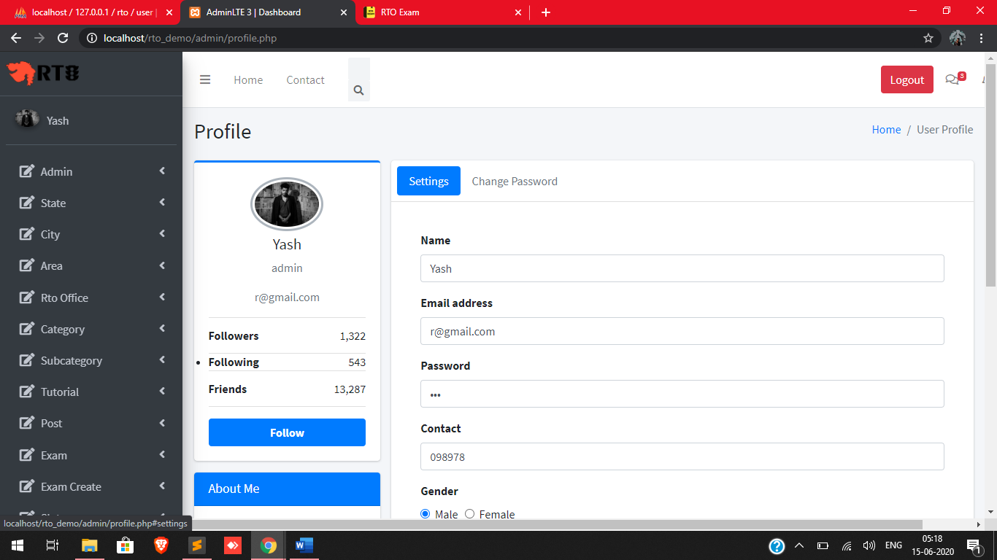

Slide 20
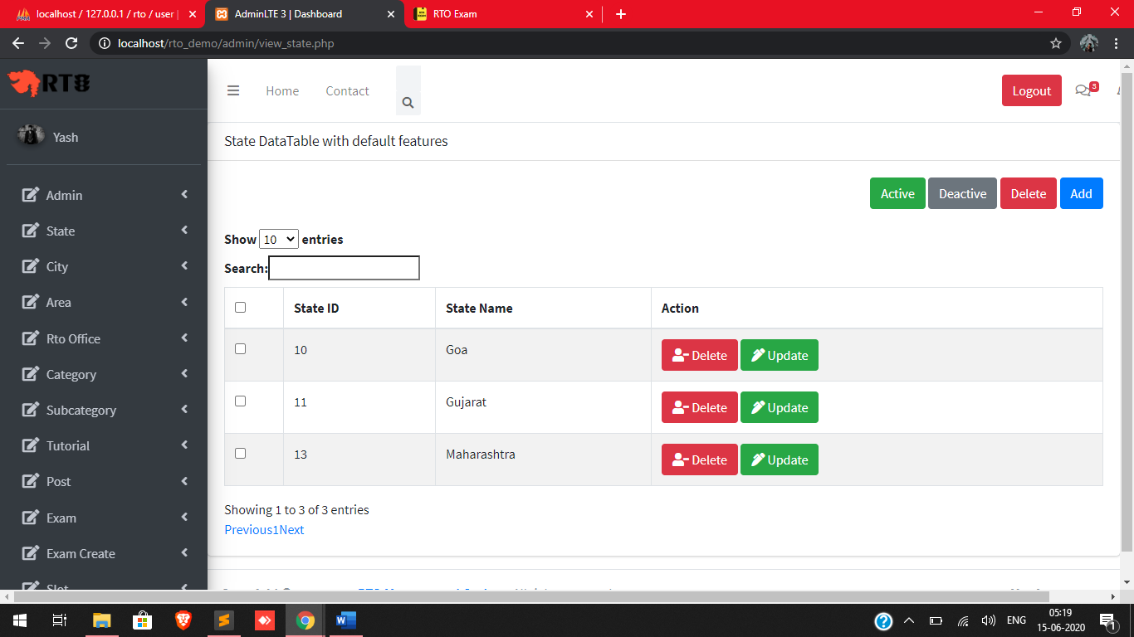

Slide 21
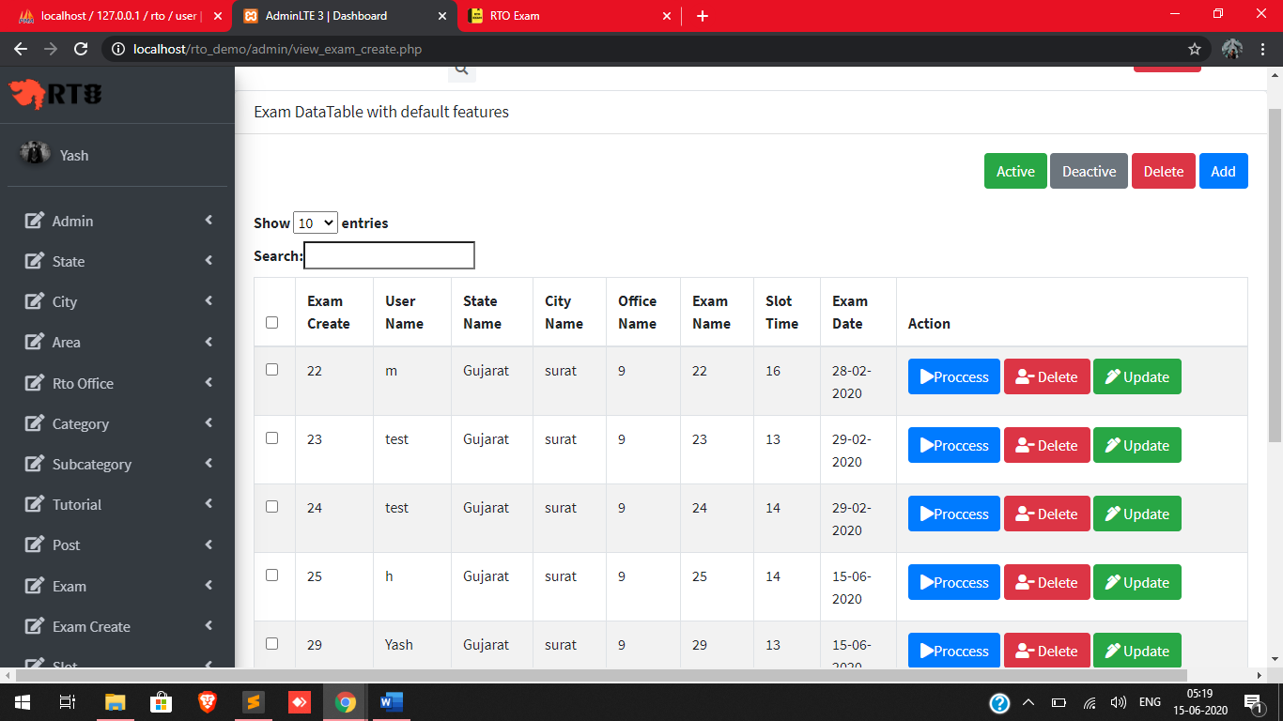

Slide 22
Admin
FIELD NAME | FIELD TYPE | CONSTRAINT | DESCRIPTION
Admin_Id | Int | Primary Key | It Indicates the Id of the Admin table.
Admin_Name | Varchar(50) | Not Null | It Contains UserName for the Admin table.
Admin_Email | Varchar(50) | Not Null | It Contains Email Id for the Admin table.
Admin_Contact | Varchar(13) | Not Null | It Contains Contact for the Admin table.
Admin_Password | Varchar(50) | Not Null | It Contains Password for the Admin table.
Admin_Gender | Varchar(50) | Not Null | It Contains Gender for the Admin table.
Admin_Hobby | Varchar(50) | Not Null | It Contains Hobby for the Admin table.
Admin_DOB | Date | Not Null | It Contains DOB for the Admin table.
Admin_Address | Varchar(50) | Not Null | It Contains Address for the Admin table.
Admin_Profile | Varchar(50) | Not Null | It Contains Profile for the Admin table.
Admin_Role | Varchar(50) | Not Null | It Contains Role for the Admin table.
Status | tinyint | Not Null | It Contains Status for the Admin table.
Created_at | timestamp | Not Null | It Contains Created At for the Admin table.
Updated_at | timestamp | Not Null | It Contains Update At for the Admin table.

Slide 23
State
FIELD NAME | FIELD TYPE | CONSTRAINT | DESCRIPTION
State_Id | Int | Primary Key | It Indicates the Id of the State table.
State_Name | Varchar(50) | Not Null | It Contains StateName for the State table.

Slide 24
City
FIELD NAME | FIELD TYPE | CONSTRAINT | DESCRIPTION
City_Id | Int | Primary Key | It Indicates the Id of the City table.
State_Id | Int | Foreign Key | It Contains the StateId of the State table.
City_Name | Varchar(50) | Not Null | It Contains CityName for the City table.

Slide 25
Area
FIELD NAME | FIELD TYPE | CONSTRAINT | DESCRIPTION
Area_Id | Int | Primary Key | It Indicates the Id of the Area table.
City_Id | Int | Foreign Key | It Contains the CityId of the City table.
State_Id | Int | Foreign Key | It Contains the StateId of the State table.
Area_Name | Varchar(50) | Not Null | It Contains Name for the Area table.

Slide 26
RTO_Office
FIELD NAME | FIELD TYPE | CONSTRAINT | DESCRIPTION
Office_Id | Int | Primary Key | It Indicates the Id of the Office table.
Area_Id | Int | Foreign Key | It Contains the AreaId of the Area table.
City_Id | Int | Foreign Key | It Contains the CityId of the City table.
State_Id | Int | Foreign Key | It Contains the StateId of the State table.
Office_Address | Varchar(50) | Not Null | It Contains Address for the RTO_Office table.

Slide 27
Category
FIELD NAME | FIELD TYPE | CONSTRAINT | DESCRIPTION
Category_Id | Int | Primary Key | It Indicates the Id of the Category table.
Category_Name | Varchar(50) | Not Null | It Contains Name for the Category table.

Slide 28
Subcategory
FIELD NAME | FIELD TYPE | CONSTRAINT | DESCRIPTION
Subcategory_Id | Int | Primary Key | It Indicates the Id of the Subcategory table.
Category_Id | Int | Foreign Key | It Contains the CategoryId of the Category table.
Subcategory_Name | Varchar(50) | Not Null | It Contains SubcategoryName for the Subcategory table.

Slide 29
Tutorial
FIELD NAME | FIELD TYPE | CONSTRAINT | DESCRIPTION
Tutorial_Id | Int | Primary Key | It Indicates the Id of the Tutorial table.
Subcategory_Id | Int | Foreign Key | It Contains the SubcategoryId of the Subcategory table.
Category_Id | Int | Foreign Key | It Contains the CategoryId of the Category table.
Tutorial_Type | Varchar(50) | Not Null | It Contains TutorialType for the Tutorial table.
Tutorial_Title | Varchar(50) | Not Null | It Contains TutorialTitle for the Tutorial table.
Tutorial_Description | Varchar(50) | Not Null | It Contains TutorialDescription for the Tutorial table.
Tutorial_Image | Varchar(50) | Not Null | It Contains TutorialImage for the Tutorial table.

Slide 30
Rules
FIELD NAME | FIELD TYPE | CONSTRAINT | DESCRIPTION
Rules_Id | Int | Primary Key | It Indicates the Id of the Rules table.
Subcategory_Id | Int | Foreign Key | It Contains the SubcategoryId of the Subcategory table.
Category_Id | Int | Foreign Key | It Contains the CategoryId of the Category table.
Rules_Title | Varchar(50) | Not Null | It Contains RulesTitle for the Rules table.
Rules_Description | Varchar(50) | Not Null | It Contains RulesDescription for the Rules table.

Slide 31
Exam
FIELD NAME | FIELD TYPE | CONSTRAINT | DESCRIPTION
Exam_Id | Int | Primary Key | It Indicates the Id of the Exam table.
State_Id | Int | Foreign Key | It Contains the StateId of the State table.
City_Id | Int | Foreign Key | It Contains the CityId of the City table.
Area_Id | Int | Foreign Key | It Contains the AreaId of the Area table.
Exam_Name | Varchar(50) | Not Null | It Contains ExamName for the Exam table.
Office_Id | Int | Foreign Key | It Contains the OfficeId of the Office table.
Slot_Id | Int | Foreign Key | It Contains the SlotId of the Slot table.
Exam_Mark | Int | Not Null | It Contains ExamMark for the Exam table.
Exam_Passing_Mark | Int | Not Null | It Contains ExamPassingMark for the Exam table.
Status | tinyint | Not Null | It Contains Status for the Exam table.
Created_at | timestamp | Not Null | It Contains Created At for the Exam table.
Updated_at | timestamp | Not Null | It Contains Update At for the Exam table.
Subcategory_Id | Int | Foreign Key | It Contains the SubcategoryId of the Subcategory table.
Category_Id | Int | Foreign Key | It Contains the CategoryId of the Category table.

Slide 32
Exam_Question
FIELD NAME | FIELD TYPE | CONSTRAINT | DESCRIPTION
Exam_Question_Id | Int | Primary Key | It Indicates the Id of the Exam_Question table.
Exam_Id | Int | Foreign Key | It Contains the ExamId of the Exam table.
Question_Id | Int | Foreign Key | It Contains the QuestionId of the Exam_Question table.
Question | Varchar(50) | Not Null | It Contains the Question of the Exam_Question table.
Ans1 | Varchar(50) | Not Null | It Contains the Ans1 of the Exam_Question table.
Ans2 | Varchar(50) | Not Null | It Contains the Ans2 of the Exam_Question table.
Ans3 | Varchar(50) | Not Null | It Contains the Ans3 of the Exam_Question table.
Ans4 | Varchar(50) | Not Null | It Contains the Ans4 of the Exam_Question table.
Final_Ans | Varchar(50) | Not Null | It Contains FinalAns for the Exam_Question table.
Status | tinyint | Not Null | It Contains Status for the Exam_Question table.
Created_at | timestamp | Not Null | It Contains Created At for the Exam_Question table.
Updated_at | timestamp | Not Null | It Contains Update At for the Exam_Question table.

Slide 33
Exam_Type
FIELD NAME | FIELD TYPE | CONSTRAINT | DESCRIPTION
Exam_Type_Id | Int | Primary Key | It Indicates the Id of the Exam_Type table.
Exam_Id | Int | Foreign Key | It Contains the ExamId of the Exam table.
Exam_Question_Id | Int | Foreign Key | It Contains the ExamQuestionId of the Exam_Question table.
Exam_Question | Varchar(50) | Not Null | It Contains the ExamQuestion of the Exam_Type table.
Exam_Ans1 | Varchar(50) | Not Null | It Contains the ExamAns1 of the Exam_Type table.
Exam_Ans2 | Varchar(50) | Not Null | It Contains the ExamAns2 of the Exam_Type table.
Exam_Ans3 | Varchar(50) | Not Null | It Contains the ExamAns3 of the Exam_Type table.
Exam_Ans4 | Varchar(50) | Not Null | It Contains the ExamAns4 of the Exam_Type table.
Exam_Final_Ans | Varchar(50) | Not Null | It Contains ExamFinalAns for the Exam_Type table.
Status | tinyint | Not Null | It Contains Status for the Exam_Type table.
Created_at | timestamp | Not Null | It Contains Created At for the Exam_Type table.
Updated_at | timestamp | Not Null | It Contains Update At for the Exam_Type table.

Slide 34
Vehicle
FIELD NAME | FIELD TYPE | CONSTRAINT | DESCRIPTION
Vehicle_Id | Int | Primary Key | It Indicates the Id of the Vehicle table.
Vehicle_Name | Varchar(50) | Not Null | It Contains VehicleName for the Vehicle table.

Slide 35
Proof
FIELD NAME | FIELD TYPE | CONSTRAINT | DESCRIPTION
Proof_Id | Int | Primary Key | It Indicates the Id of the Proof table.
Proof_Name | Varchar(50) | Not Null | It Contains ProofName for the Proof table.

Slide 36
Post
FIELD NAME | FIELD TYPE | CONSTRAINT | DESCRIPTION
Post_Id | Int | Primary Key | It Indicates the Id of the Post table.
Subcategory_Id | Int | Foreign Key | It Contains the SubcategoryId of the Subcategory table.
Category_Id | Int | Foreign Key | It Contains the CategoryId of the Category table.
Post_Type | Varchar(50) | Not Null | It Contains PostType for the Post table.
Post_Title | Varchar(50) | Not Null | It Contains PostTitle for the Post table.
Post_Description | Varchar(50) | Not Null | It Contains PostDescription for the Post table.

Slide 37
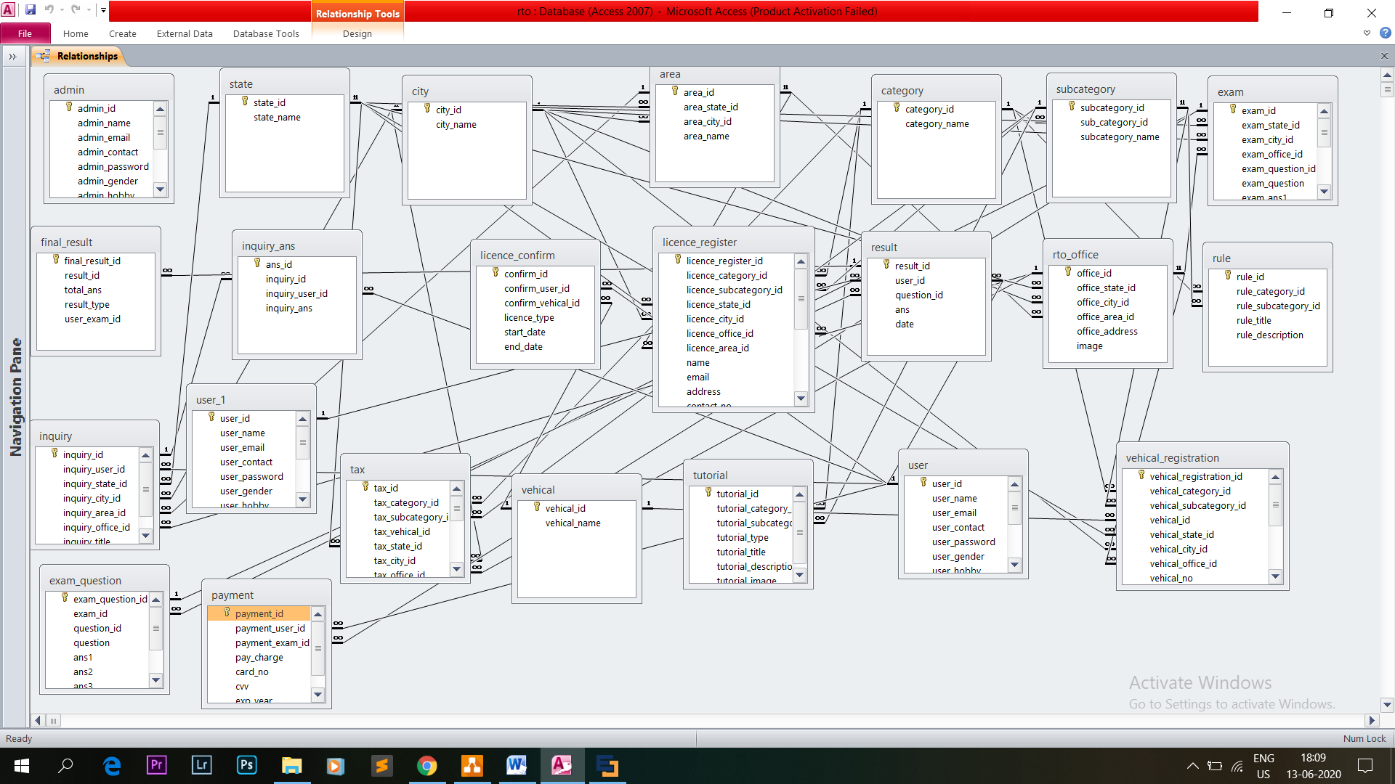
DATABASE DESIGN

Slide 38
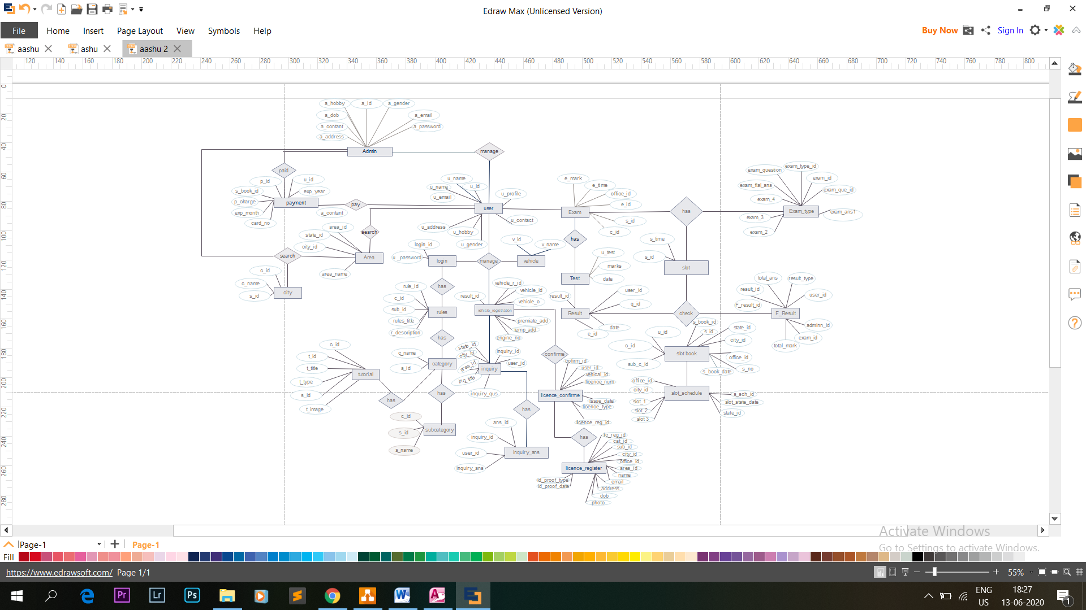
ER-Diagram

Slide 39
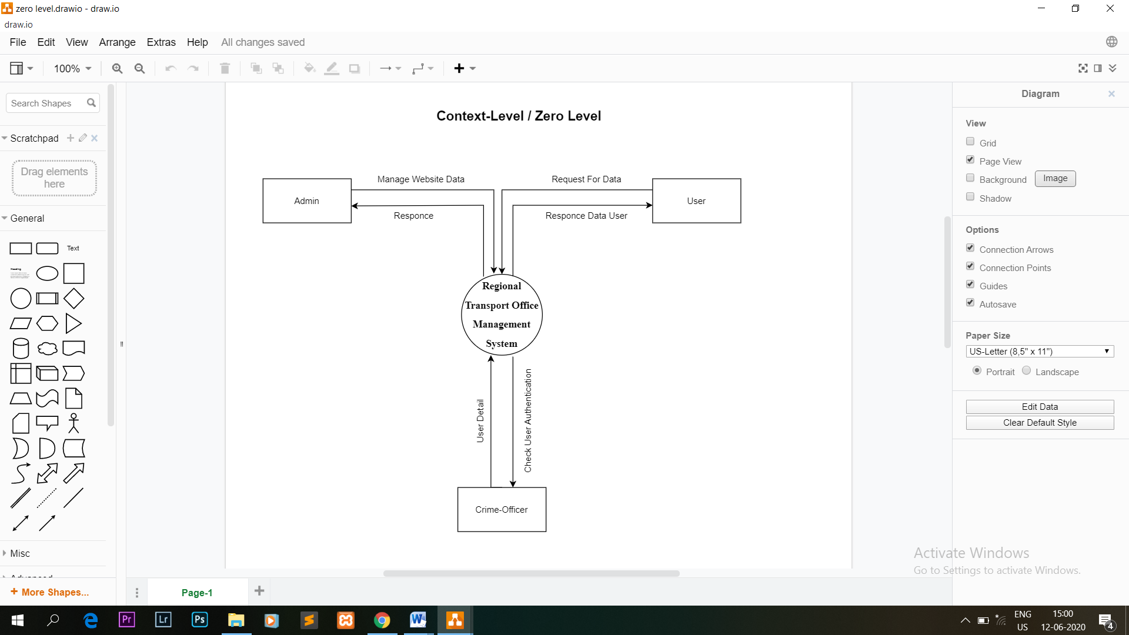
DATA FLOW DIAGRAM

Slide 40
TIME LINE CHART
Week | 2 | 3 | 4 | 5 | 6 | 7 | 8 | 9 | 10 | 11 | 12 | 13 | 14 | 15 | 16 |  | 17 | 18 | 19 | 20 | 21
Month/ Week | December |  |  |  | January |  |  |  | February |  |  |  | March |  |  |  |  | April
Requirement Gathering
Analysis
Coding
Designing
Testing
Implementation
Documentation

Slide 41
Reference
https://www.google.co.in/
https://www.wikipedia.org/
https://parivahan.gov.in/parivahan/
https://sarathi.parivahan.gov.in/sarathiservice/

Slide 42
THANK YOU!!
Presented By:
VIRAL TADA

